Slide 1
Housing Trends Prediction
Saad Azhar
Pranav Makhijani

Slide 2
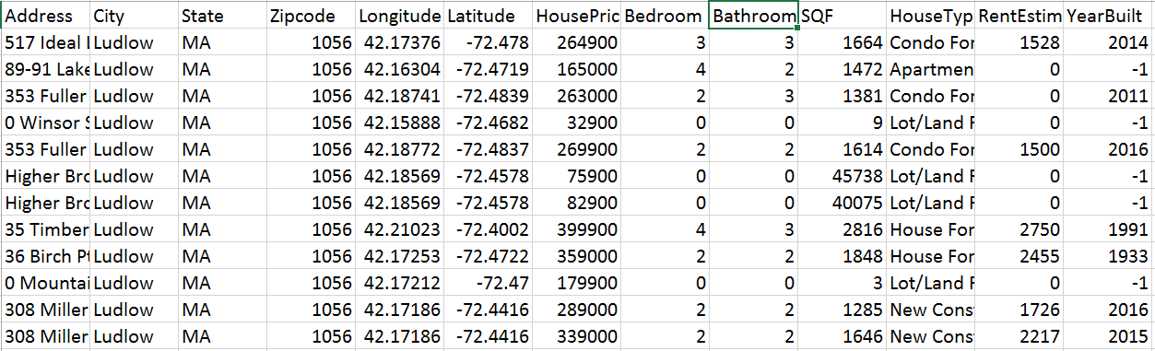
Introduction
Motivation
Dataset

Slide 3
SDK Environment
Anaconda-Spyder
Python

Slide 4
Roadmap
Data Exploration
Data Pre-Processing
Random Forest (Feature Selection)
Support Vector Machines
Artificial Neural Networks
Data Visualization

Slide 5
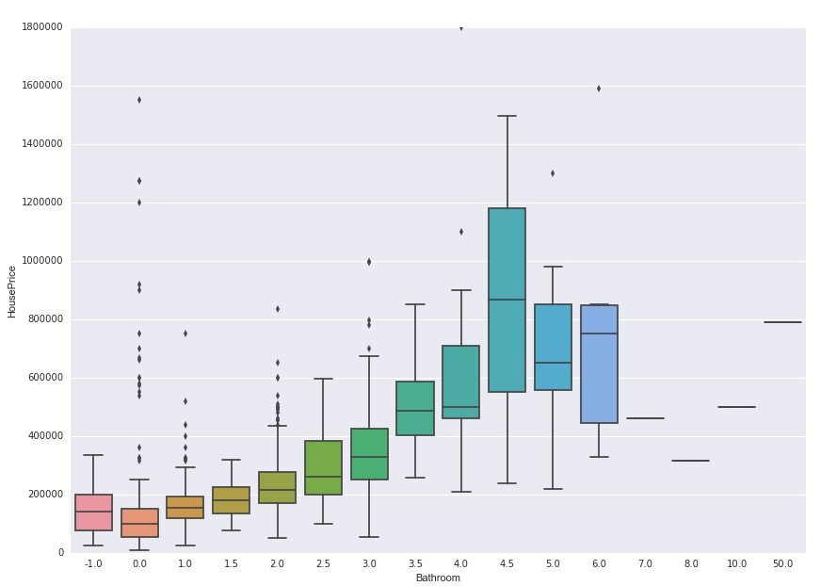
Bathrooms Vs House Price

Slide 6
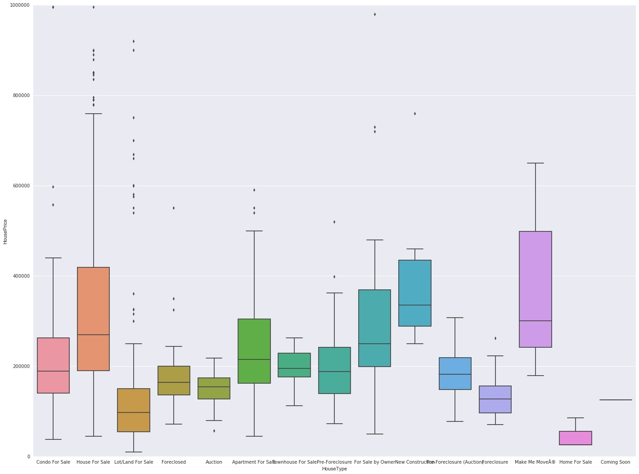
House Type Vs House Price

Slide 7
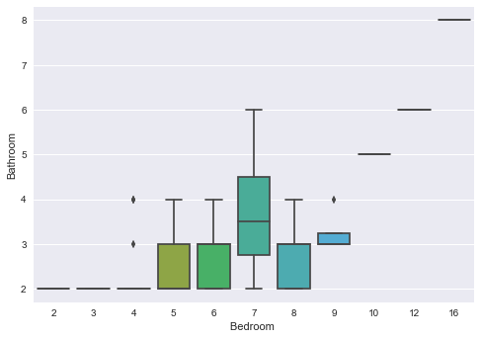
Bedroom Vs Bathrooms

Slide 8
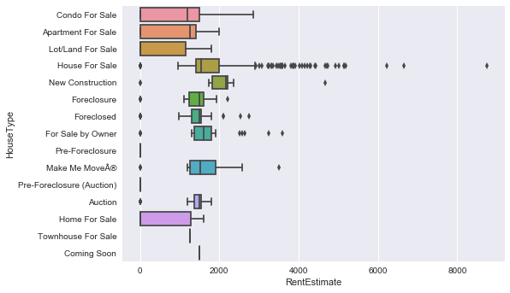
House Type Vs Rent

Slide 9
Rent Estimates With Null Values

Slide 10
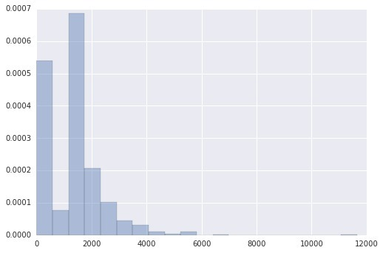
Rent Estimate Plot

Slide 11
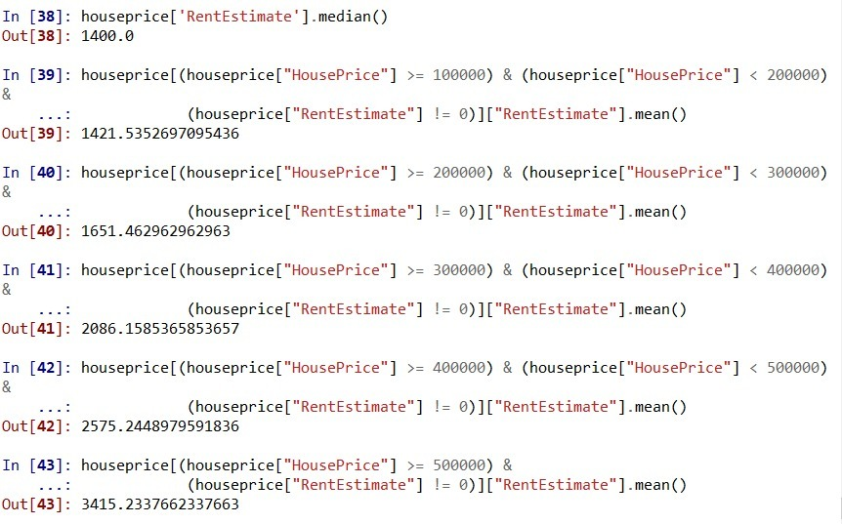
Feature Engineering to Impute Values

Slide 12
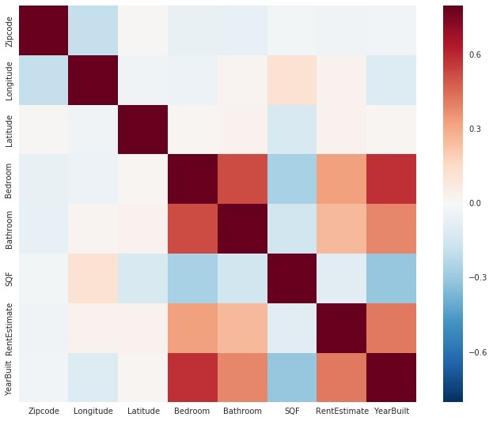
Co-relation Heat Map

Slide 13
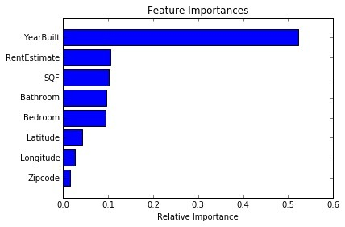
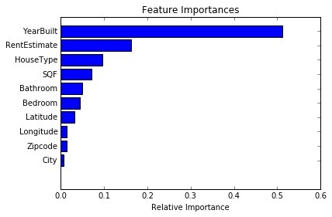
Feature Selection using Random Forest
Saad’s dataset
Pranav’s dataset

Slide 14
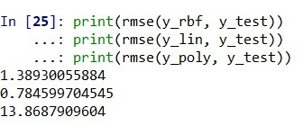
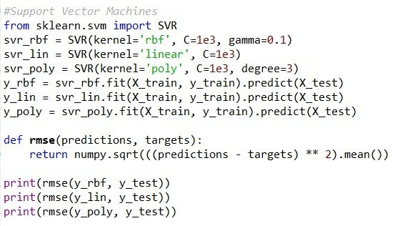
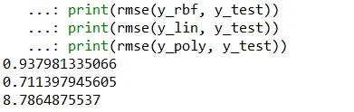
Support Vector Machines - Regression
Kernels used: Linear, Polynomial, RBF
C: 0.1, 1, 100, 500, 1000
Model Comparison - Pranav
Model Comparison - Saad

Slide 15
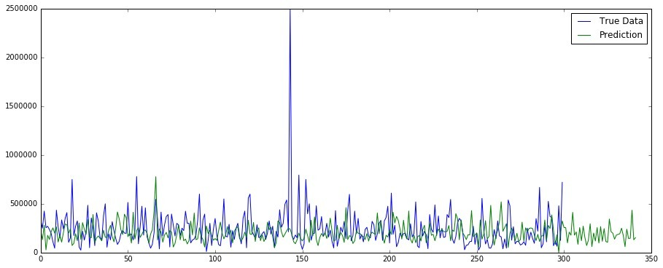
SVM Visualization - Saad

Slide 16
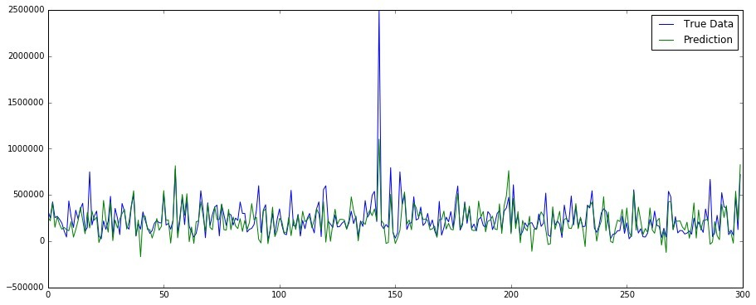
SVM Visualization - Pranav

Slide 17
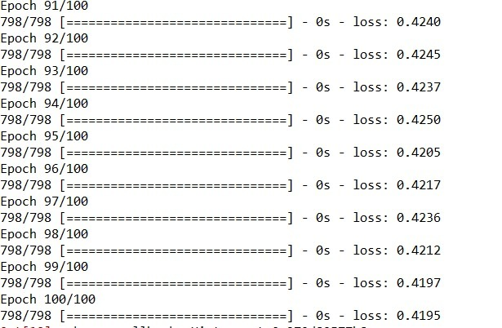
Artificial Neural Network Results - Saad’s dataset
One hundred epochs:
Mean Squared Error & Root Mean Squared Error:

Slide 18
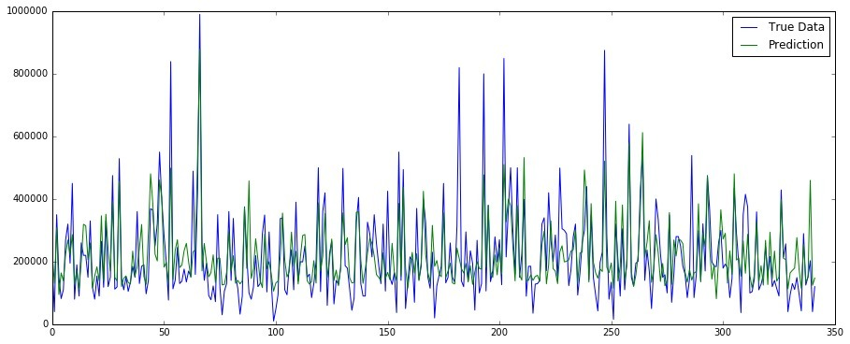
Predicted vs Actual Plot

Slide 19
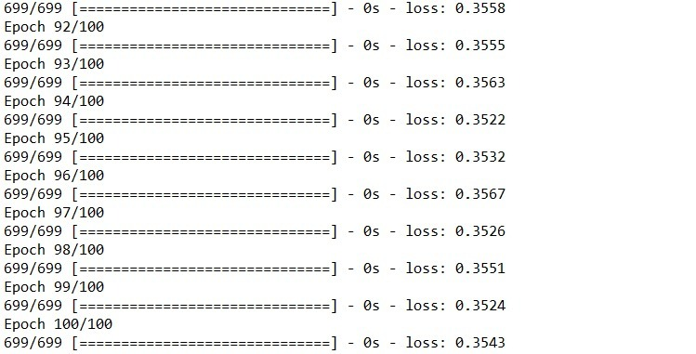

Artificial Neural Network Results - Pranav’s dataset
One hundred epochs:
Mean Squared Error & Root Mean Squared Error:

Slide 20
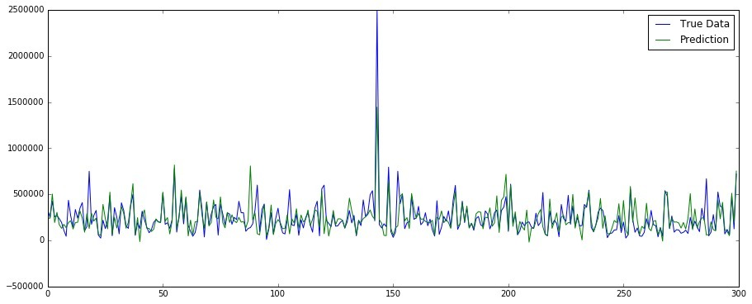
Predicted vs Actual Plot

Slide 21
Challenges
Dealing with inconsistency of data values.
Treating Outliers
Dealing with interpretation of Neural Network Results.
Understanding and comparing the results from two different datasets.

Slide 22


